Slide 1

Session Learning Outcome SLO
Topological Spaces

Slide 2
Topological space
An open set is a member of a given collection of subsets of a given set, a collection that has the property of containing every union of its members, every finite intersection of its members, the empty set, and the whole set itself. A set in which such a collection is given is called a topological space, and the collection is called a topology.
Open sets: No limit points
Closed sets: A set is closed if and only if it contains all of its limit points
A topological space is a geometrical space in which closeness is defined but cannot necessarily be measured by a numeric distance.
More specifically, a topological space is a set whose elements are called points, along with an additional structure called a topology, which can be defined as a set of neighborhoods for each point that satisfy some axioms formalizing the concept of closeness.

Slide 3
Point-Set Topology
The fundamental concepts in point-set topology are continuity, compactness, and connectedness:
Continuous functions, intuitively, take nearby points to nearby points.
Compact sets are those that can be covered by finitely many sets of arbitrarily small size.
Connected sets are sets that cannot be divided into two pieces that are far apart.
The terms 'nearby', 'arbitrarily small', and 'far apart' can all be made precise by using the concept of open sets

Slide 4
Examples of topological spaces
Discrete topologies
Any set can be given the discrete topology, in which every subset is open.
The only convergent sequences or nets in this topology are those that are eventually constant.
Trivial topologies
Any set can be given the trivial topology (also called the indiscrete topology), in which only the empty set and the whole space are open.
Every sequence and net in this topology converges to every point of the space.
This example shows that in general topological spaces, the limits of sequences need not be unique.
However, often topological spaces must be Hausdorff spaces where limit points are unique.

Slide 5
Cofinite topology
Any set can be given the cofinite topology in which the open sets are the empty set and the sets whose complement is finite. This is the smallest T₁ topology on any infinite set.
Cocountable topology
Any set can be given the cocountable topology, in which a set is defined as open if it is either empty or its complement is countable.

Slide 6
Topologies on the real and complex numbers
There are many ways to define a topology on R, the set of real numbers.
The standard topology on R is generated by the open intervals.
The set of all open intervals forms a base or basis for the topology, meaning that every open set is a union of some collection of sets from the base.
In particular, this means that a set is open if there exists an open interval of non-zero radius about every point in the set.
More generally, the Euclidean spaces R^{n} can be given a topology.
In the usual topology on R^{n} the basic open sets are the open balls.
Similarly, C, the set of complex numbers, and C^{n} have a standard topology in which the basic open sets are open balls.

Slide 7
Metric topology
Every metric space can be given a metric topology, in which the basic open sets are open balls defined by the metric.
This is the standard topology on any normed vector space.
On a finite-dimensional vector space this topology is the same for all norms.

Slide 8
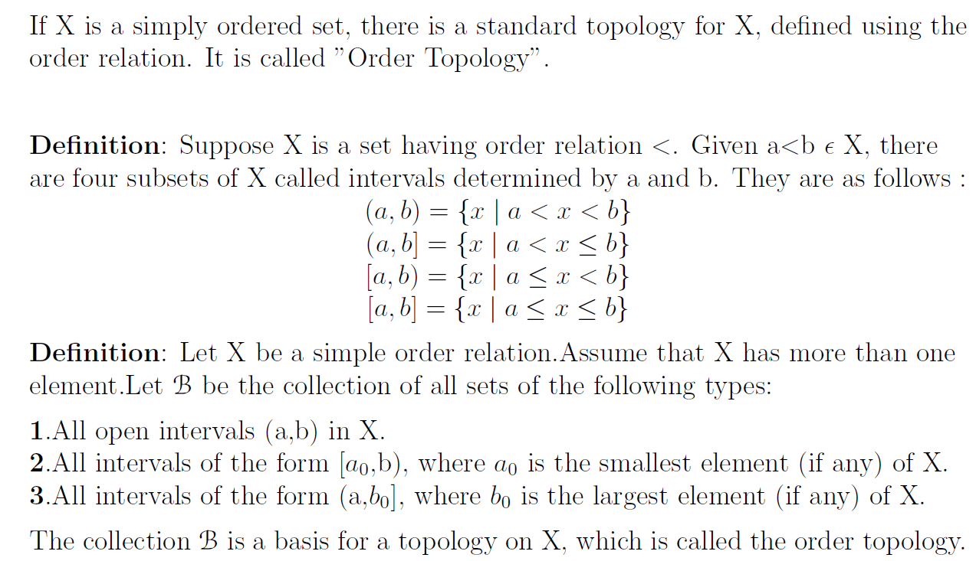
Order Topology

Slide 9
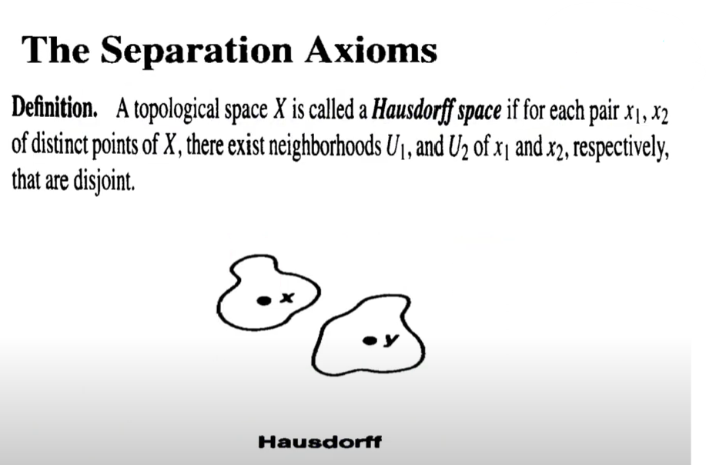
Hausdorff Space

Slide 10
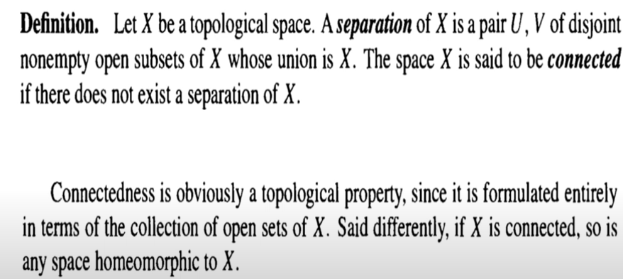
Separation and Connectedness

Slide 11
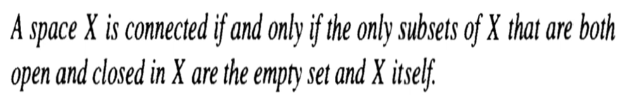
Connected Spaces

Slide 12
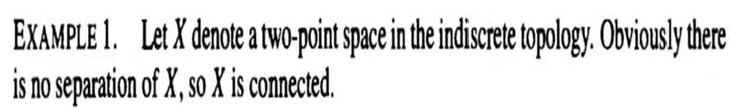
Example1 Connected Spaces

Slide 13
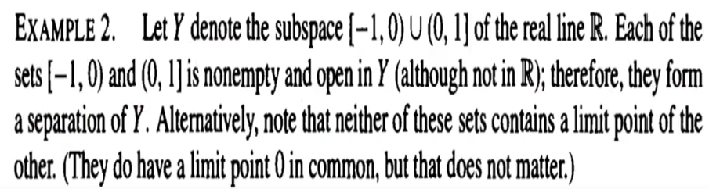
Example1 Connected Spaces

Slide 14
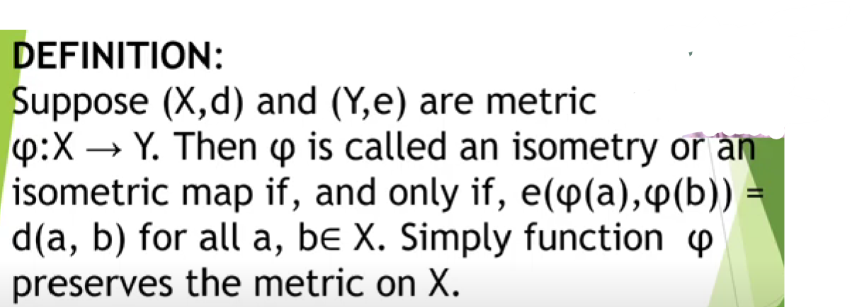
Isometry or Isometric Map

Slide 15
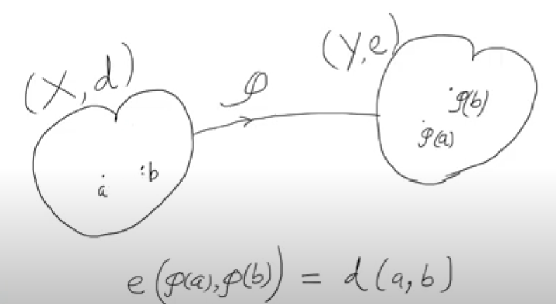
Isometry or Isometric Map

Slide 16
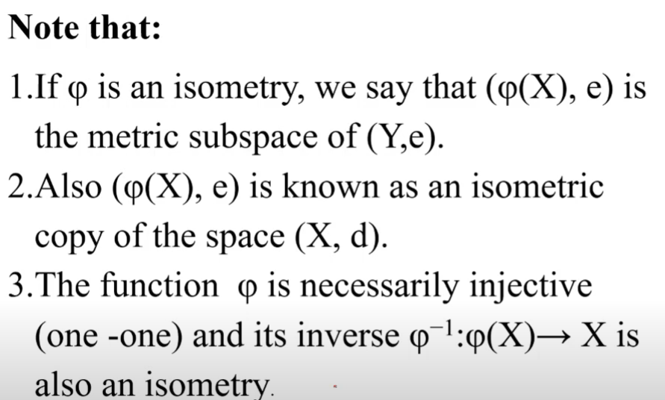
Isometry or Isometric Map

